Slide 1
Hidden Markov Model and its Applications in NLP
Prof. Alaa Hamdy

Slide 2
Introduction
A Hidden Markov Model (HMM) is a statistical model which is also used in machine learning. It can be used to describe the evolution of observable events that depend on internal factors, which are not directly observable.

Slide 3
The use of HMM for PoS tagging
What is POS-tagging?
There are commonly nine parts of speeches; noun, pronoun, verb, adverb, article, adjective, preposition, conjunction, interjection, and a word need to be fit into the proper part of speech to make sense in the sentence.

Slide 4
Example
Let’s take the sentence “Anthony will eat food” where Anthony is a noun, will is a modal, eat is a verb and food is also a noun, so the probability for a word to be in a particular class of part of speech is called the Emission probability.
As we can seen in the example of the HMM process in POS tagging the transition probability is the likelihood of any sequence for example what are the chances for a noun word to come after any modal and a modal after a verb and a verb after a noun.

Slide 5
Let’s take a look at how we can calculate these two probabilities for a set of sentences:
Mary Jane can see will
The spot will see Mary
Will Jane spot Mary?
Mary will pat Spot

Slide 6
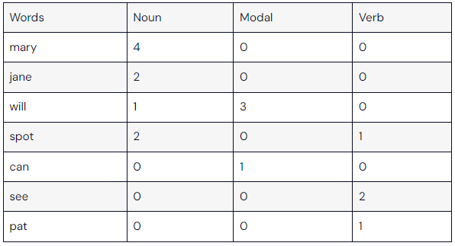
The below table is a counting tableau for the words with their part of speech type
Mary Jane can see will
The spot will see Mary
Will Jane spot Mary?
Mary will pat Spot

Slide 7
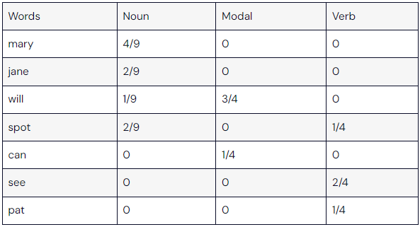
Let’s divide each word’s appearance by the total number of every part of speech in the set of sentences.
Here in the table, we can see the emission probabilities of every word.

Slide 8
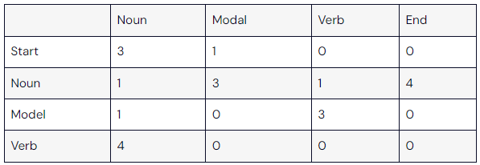
Mary Jane can see will
The spot will see Mary
Will Jane spot Mary?
Mary will pat Spot
Here the above values in the table are the respective transition values for a given set of sentences.

Slide 9
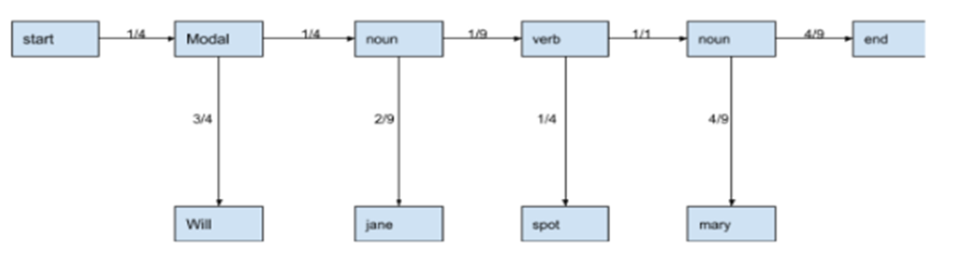
Let’s take the sentence “Will Jane spot Mary?” out from the set and now we can calculate the probabilities for every part of speech using the above calculations.
In the above image, we can see that we have emission probabilities of the words in the sentence given in the vertical lines and the horizontal lines are representing all the transition probabilities.

Slide 10
The correctness of the POS tagging
Now the correctness of the POS tagging is measured by the product of all these probabilities. The product of probabilities represents the likelihood that the sequence is right.
Let’s just check for the rightness of the POS tagging.
¼*¾*¼*2/9*1/9*¼*1/1*4/9*4/9 = 5.7155921353452217649748513946045e-5
Here we can see that the product is higher than zero which means the POS tagging we have performed is correct and if the result is zero then the tagging performed will not be correct.

Slide 11
So here we have seen how the HMM,s algorithm works for providing the POS tagging to the sentences but the example was small where we had only 3 kinds of POS tags but there are 81 different kinds of POS tags available.

Slide 12
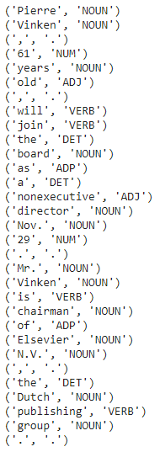
The image shown is a representation of the words with the tags on them presented in the dataset.
In the data which we are using we have 12 unique tags on it. Like the following image.

Slide 13
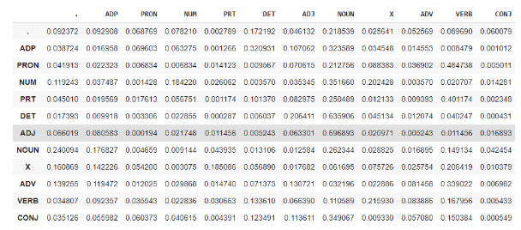
The below image represents the transition probability table.

Slide 14

In the table we can see that we have almost no zero values. By this also we can say the tagging on the data is almost correct also we can optimize it using the Viterbi algorithm.
The table is a result of ten sentences of the data set where we can see that we almost get 94% accuracy.

